Slide 1
Object Creation
Prof. Dr. Dirk Riehle
Friedrich-Alexander University Erlangen-Nürnberg
ADAP C09
Licensed under CC BY 4.0 International
Notes:
It is Friedrich-Alexander University Erlangen-Nürnberg – FAU, in short.
Corporate identity wants us to say “Friedrich-Alexander University”.

Slide 2
Agenda
Object creation patterns
Switch / case statement
Factory method
Abstract factory
Product trader
Prototype (cloning)
Object creation reviewed
Object creation model

Slide 3
1. Object Creation Patterns

Slide 4
(Design) Patterns of Object Creation
Switch / Case
Factory Method
(Abstract) Factory
Product Trader
Prototype

Slide 5
Object Creation Example
Create a document from its file type (extension)
Create an application for the document

Slide 6
Evaluation Criteria
 | Easy (1) | Normal (2) | Harder (3)
Reading | Same method | In subclass | In other class
Changing (with access to code) | In one place | In two places | In multiple places
Extending (when you can’t change) | In client | In subclass | In place

Slide 7
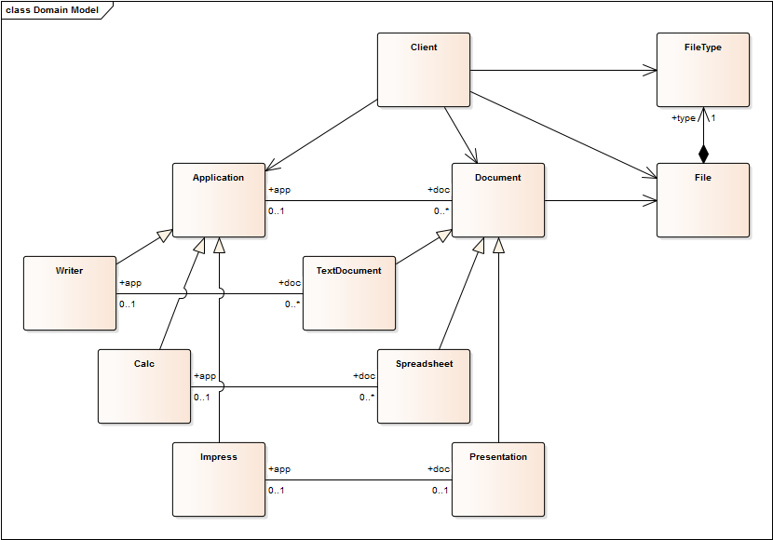
Application Document Model

Slide 8
2. Switch / Case Statement

Slide 9
Scenario 1: File-type → Document
Client is run-time environment, e.g. desktop
Wants to create document for given file

Slide 10
Switch / Case Applied
public class Client {
public Document createDocument(File file) {
String fileType = file.getFileType();
Document result = null;
if (fileType.equals("odt")) {
result = new TextDocument();
} else if (fileType.equals("ods")) {
result = new Spreadsheet();
} else if (fileType.equals("odp")) {
result = new Presentation();
}
...
return result;
}
...
}

Slide 11
Switch / Case Evaluated
Evaluation
  Easy (1) to read
  With access to code, easy (1) to change
  Without access to code, normal (2) to extend (you can extend by overriding in subclass)
Additional notes
  May require use of initialization method

Slide 12
3. Factory Method

Slide 13
Scenario 2: Application → Document
Client is run-time environment, e.g. desktop
Wants to create document for given application

Slide 14
Factory Method Applied
public abstract class Application {
public abstract Document createDocument();
...
}
public class Writer extends Application {
public Document createDocument() { return new TextDocument(); }
...
}
public class Calc extends Application {
public Document createDocument() { return new Spreadsheet(); }
...
}
public class Impress extends Application {
public Document createDocument() { return new Presentation(); }
...
}

Slide 15
Factory Method Evaluated
Evaluation
  Normal (2) to read
  With access to code, easy (1) to change
  Without access to code, normal (2) to extend (by overriding factory method)

Slide 16
4. Abstract Factory

Slide 17
Scenario 3: File-type → Document (v2)
Client is run-time environment, e.g. desktop
Wants to create document for given file
Wants to add new Document types in one place

Slide 18
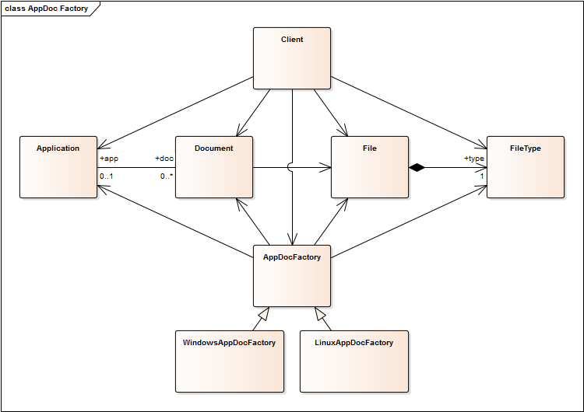
Application Document Factory

Slide 19
Abstract Factory Applied
public interface AppDocFactory {
public Application createFrom(Document doc);
public Document createFrom(File file);
...
}
public class DefaultAppDocFactory implements AppDocFactory {
...
public Document createFrom(File file) {
String fileType = file.getFileType();
if (fileType.equals("odt")) {
result = new TextDocument();
} else if ...
return result;
}
...
}

Slide 20
Abstract Factory Evaluated
Evaluation
  Harder (3) to read (you have to trace calls to factory)
  With access to code, normal (2) to change (you have to touch multiple places)
  Without access to code, normal (2) to extend (you have to substitute factory object)
Additional notes
  Factories are versatile, advantages and disadvantages depend on further choices like
    How to implement the creation methods

Slide 21
5. Product Trader

Slide 22
Scenario 4: Document → Application
Client is run-time environment, e.g. desktop
Wants to create application for given document
Wants to add new Application types in one place

Slide 23
Product Trader Applied 1 / 2
public interface AppDocFactory {
public void registerApplicationClass(Class dc, Class ac);
public Application createFrom(Document doc);
...
}
public class DefaultAppDocFactory implements AppDocFactory {
Map<Class, Class> appClasses = new HashMap<Class, Class>();
static {
appClasses.put(TextDocument.class, Writer.class);
appClasses.put(Spreadsheet.class, Calc.class);
appClasses.put(Presentation.class, Impress.class);
}
...
}

Slide 24
Product Trader Applied 2 / 2
public class DefaultAppDocFactory implements AppDocFactory {
Map<Class, Class> appClasses = new HashMap<Class, Class>();
public void registerApplicationClass(Class dc, Class ac) {
assert (dc != null) && (ac != null);
appClasses.put(dc, ac);
}
public Application createFrom(Document doc) {
Class appClass = appClasses.get(doc.getClass());
assert appClass != null;
return createInstance(appClass);
}
protected Application createInstance(Class ac) {
...
}
...
}

Slide 25
Product Trader Evaluated
Evaluation
  Harder (3) to read (you have to trace calls to and understand factory)
  With access to code, normal (2) to change (you have to touch multiple places)
  Without access to code, easy (2) to extend (by configuring)
Additional notes
  Product Trader delays everything until runtime
  May be viewed as just a complex (abstract) factory

Slide 26
6. Prototype (Cloning)

Slide 27
Scenario 5: File-type → Document (v3)
Client is run-time environment, e.g. desktop
Wants to create document for given file type
Wants to add new Document types in one place
Wants to initialize complex but default document

Slide 28
Prototype Applied 1 / 2
public interface AppDocFactory {
public void registerDocumentPrototype(FileType ft, Document doc);
public Document createFrom(FileType ft);
...
}

Slide 29
Prototype Applied 2 / 2
public class DefaultAppDocFactory implements AppDocFactory {
Map<String, Document> docProtos = new HashMap<String, Document>();
public void registerDocumentPrototype(FileType ft, Document doc) {
assert (ft != null) && (doc != null);
docProtos.put(ft, doc);
}
public Document createFrom(FileType ft) {
Document prototype = docProtos.get(ft);
assert (prototype != null) && (prototype.isCloneable());
return prototype.clone();
}
...
}

Slide 30
Prototype Evaluated
Advantages
  Normal (2) to read (the call to clone() gives it away)
  With access to code, normal (2) to change (you have to change prototype creation)
  Without access to code, easy to extend (you have to reconfigure prototype creation)
Disadvantages
  Hard to understand

Slide 31
7. Object Creation Reviewed

Slide 32
Problems with Using Design Patterns
Many design patterns address multiple issues at once, e.g.
  Factory method: Creation method and subclassing for configuration
  Abstract factory: Factory object and subclassing for configuration
  Prototype: Creation configuration and complex object structures
But that is often intentional: The combination is the pattern

Slide 33
Design Process for Object Creation
Use your experience
Use a pattern language
Choose from design space
  Delegation (of object creation)
  Selection (of concrete class)
  Configuration (of class mapping)
  Instantiation (of concrete class)
  Initialization (of new object)
  Building (of object structure)

Slide 34
8. Object Creation Model

Slide 35
Design Space for Object Creation
Delegation of object creation
Selection of concrete class
Configuration of class mapping
Instantiation of concrete class
Initialization of new object
Building of object structure

Slide 36
Details of Design Space for Object Creation
Delegation (Who gets to create the object?)
  on-the-spot, this-object, separate-object
Selection (How is the concrete class selected?)
  on-the-spot, by-switch-case, by-subclassing, by-colocating, by-mapping
Configuration (How is a class mapping configured?)
  in-code, by-annotation, by-configuration-file
Instantiation (How is the concrete class instantiated?)
  in-code, by-class-object, by-prototype, by-function-object
Initialization (How is the new object initialized?)
  default, by-cloning, by-fixed-signature, by-key-value-pairs, in-second-step
Building (How is the object structure built?)
  default, by-cloning, by-building

Slide 37
1. Delegation of Object Creation
On-the-spot
  Definition: Hard-code in client code
  Use: If product class is unlikely to change, ever
By delegating to this-object
  Definition: Delegate to separate (creation) method
  Use: If this class has multiple places that need this type of new object
By delegating to a separate-object
  Definition: Delegate to a separate (factory) object
  Use: If many places in the system need to create new objects of this type

Slide 38
2. Selection of Concrete Class
On-the-spot
  Definition: Hard-code in place (whether this method, this class or factory)
  Use: If there is no need for varying the concrete class, ever
By-switch-case statement
  Definition: Hard-code in place using switch/case statement
  Use: If there are multiple options, none of which changes, ever
By-subclassing
  Definition: Select concrete class by delegating to subclass
  Use: If you need a family and dual hierarchies need to be satisfied
By-colocating
  Definition: Select concrete class as part of a family selection
  Use: If your concrete class is part of a family of co-dependent classes
By-mapping
  Definition: Look-up concrete class as part of some spec → class mapping
  Use: If your concrete class needs to be configurable at runtime

Slide 39
3. Configuration of Class Mapping
In-code
  Definition: Hard-code mapping in configuration method
  Use: If you need a mapping, but it is unlikely to change, ever
By-annotation
  Definition: Use annotations to (incrementally) configure mapping
  Use: If your mapping is small and does not need to be centralized
By-configuration-file
  Definition: Read mapping from configuration file
  Use: If you need to manage large and changing mappings

Slide 40
4. Instantiation of Concrete Class
In-code
  Definition: Call constructor (new) directly
  Use: If there is no need for configuration
By-class-object
  Definition: Represent each concrete class using its class object
  Use: If you don’t need specialized initialization
By-prototype
  Definition: Represent each concrete class using a prototype (object)
  Use: If you don’t need specialized initialization and don’t have class objects
By-function-object
  Definition: Represent each concrete class using a function object
  Use: If you need specialized initialization or don’t have class objects

Slide 41
5. Initialization of New Object
Default
  Definition: Provide a fixed (default) field assignment in constructor
  Use: If there is no need for client-specific initialization (or it can be done later)
By-cloning
  Definition: Provide a fixed field assignment by cloning a prototype
  Use: If there is no need for a client-specific initialization
By-fixed-signature
  Definition: Provide a field assignment using a fixed method signature
  Use: If you can channel everything though a fixed method signature
By-key-value-pair list
  Definition: Provide a field assignment using a variable argument list
  Use: If considerable variation is possible and needed in object initialization
In-second-step
  Definition: Push back object initialization to client until after creation finished
  Use: If there is too much variation in the initialization arguments

Slide 42
6. Building of Object Structure
Default
  Definition: Let the new object create any dependent object structure
  Use: If the client wants no say in creating any dependent objects
By-cloning
  Definition: Create the desired object structure by cloning a prototype
  Use: If someone else needs to define the object structure for the client
By-building
  Definition: Create the desired object structure by building it piece-by-piece
  Use: If the client needs to direct the building of a complex object structure

Slide 43
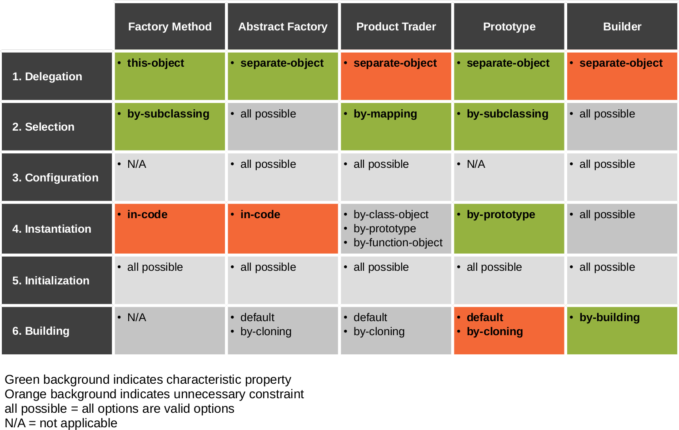
Design Patterns and Design Space

Slide 44
Review / Summary of Session
Object creation patterns
Switch / case statement
Factory method
Abstract factory
Product trader
Prototype (cloning)
Object creation reviewed
Object creation model

Slide 45
Thank you! Questions?
dirk.riehle@fau.de – https://oss.cs.fau.de
dirk@riehle.org – https://dirkriehle.com – @dirkriehle
DR

Slide 46
Legal Notices
License
  Licensed under the CC BY 4.0 International License
Copyright
  © 2012-2022 Dirk Riehle, some rights reserved

